Slide 1
The Relational Model
Jianlin Feng
School of Software
SUN YAT-SEN UNIVERSITY

Slide 2
Relational Database: Definitions
Relational database:
  a set of relations.
Relation: made up of 2 parts:
  Schema : specifies name of relation, plus name and type of each column.
    E.g. Students(sid: string, name: string, login: string, age: integer, gpa: real)
  Instance : a table, with rows and columns.
    #rows = cardinality
    #fields = arity (or degree)
Can think of a relation as a set of rows or tuples.
  i.e., all rows are distinct

Slide 3
Ex: Instance of Students Relation
sid
name
login
age
gpa
536
6
6
Jones
jones
@
cs
18
3.4
536
8
8
Smith
smith@e
e
cs
18
3.2
536
5
0
Smith
smith
@m
ath
19
3.8
Cardinality = 3, arity = 5 , all rows distinct
Do all values in each column of a relation instance
have to be distinct?

Slide 4
SQL - A language for Relational DBs
SQL (a.k.a. “Sequel”), standard language
Data Definition Language (DDL)
  create, modify, delete relations
  specify constraints
  administer users, security, etc.
Data Manipulation Language (DML)
  Specify queries to find tuples that satisfy criteria
  add, modify, remove tuples

Slide 5
SQL Overview
CREATE TABLE <name> ( <field> <domain>, … )
INSERT INTO <name> (<field names>)
VALUES (<field values>)
DELETE FROM <name>
WHERE <condition>
UPDATE <name>
SET <field name> = <value>
WHERE <condition>
SELECT <fields>
FROM <name>
WHERE <condition>

Slide 6
Creating Relations in SQL
Creates the Students relation.
  Note: the type (domain) of each field is specified, and enforced by the DBMS whenever tuples are added or modified.
CREATE TABLE Students
(sid CHAR(20),
name CHAR(20),
login CHAR(10),
age INTEGER,
gpa FLOAT)

Slide 7
Table Creation (Cont.)
Another example:
  the Enrolled table holds information about courses students take.
CREATE TABLE Enrolled
(sid CHAR(20),
cid CHAR(20),
grade CHAR(2))

Slide 8
Adding and Deleting Tuples
Can insert a single tuple using:
INSERT INTO Students (sid, name, login, age, gpa)
VALUES ('53688', 'Smith', 'smith@ee', 18, 3.2)
Can delete all tuples satisfying some condition (e.g., name = Smith):
DELETE
FROM Students S
WHERE S.name = 'Smith'

Slide 9
Keys
Keys are a way to associate tuples in different relations.
Keys are one form of integrity constraint (IC)
Enrolled
Students
sid
cid
grade
53666
Carnatic101
C
sid
name
login
age
gpa
53666
Reggae203
B
53666
Jones
jones@cs
18
3.4
53650
Topology112
A
53688
Smith
smith@eecs
18
3.2
53666
History105
B
53650
Smith
smith@math
19
3.8
FOREIGN Key
PRIMARY Key

Slide 10
Primary Keys
A set of fields is a superkey if:
  No two distinct tuples can have same values in all key fields
A set of fields is a key for a relation if :
  It is a superkey
  No subset of the fields is a superkey. (i.e., minimal).
what if more than one keys for a relation?
  One of the keys is chosen (by DBA) to be the primary key. Other keys are called candidate keys.
E.g.
  sid is a key for Students.
  What about name?
  The set {sid, gpa} is a superkey.

Slide 11
Primary and Candidate Keys in SQL
Possibly many candidate keys (specified using UNIQUE), one of which is chosen as the primary key.
Keys must be used carefully!
“For a given student and course, there is a single grade.”
CREATE TABLE Enrolled
(sid CHAR(20)
cid CHAR(20),
grade CHAR(2),
PRIMARY KEY (sid,cid))
CREATE TABLE Enrolled
(sid CHAR(20),
cid CHAR(20),
grade CHAR(2),
PRIMARY KEY (sid),
UNIQUE (cid, grade))
vs.
“Students can take only one course, and no two students in a course receive the same grade.”

Slide 12
Foreign Keys vs. Referential Integrity
Foreign key: Set of fields in one relation that is used to `refer’ to a tuple in another relation.
  Must correspond to the primary key of the other relation.
  Like a `logical pointer’.
If all foreign key constraints are enforced, referential integrity is achieved (i.e., no dangling references.)

Slide 13
Foreign Keys in SQL
E.g. Only students listed in the Students relation should be allowed to enroll for courses.
  sid is a foreign key referring to Students:
CREATE TABLE Enrolled
(sid CHAR(20),cid CHAR(20),grade CHAR(2),
PRIMARY KEY (sid,cid),
FOREIGN KEY (sid) REFERENCES Students )
Enrolled
Students
sid
cid
grade
sid
name
login
age
gpa
53666
Carnatic101
C
53666
Jones
jones@cs
18
3.4
53666
Reggae203
B
53650
Topology112
A
53688
Smith
smith@eecs
18
3.2
53666
History105
B
53650
Smith
smith@math
19
3.8
11111 English102 A

Slide 14
Enforcing Referential Integrity
sid in Enrolled: foreign key referencing Students.
Scenarios:
  Insert Enrolled tuple with non-existent student id?
  Delete a Students tuple?
    Also delete Enrolled tuples that refer to it? (Cascade)
    Disallow if referred to? (No Action)
    Set sid in referring Enrolled tuples to a default value? (Set Default)
    Set sid in referring Enrolled tuples to null, denoting `unknown’ or `inapplicable’. (Set NULL)
Similar issues arise if primary key of Students tuple is updated.

Slide 15
Integrity Constraints (ICs)
IC: condition that must be true for any instance of the database
  e.g., domain constraints.
  ICs are specified when schema is defined.
  ICs are checked when relations are modified.
A legal instance of a relation is one that satisfies all specified ICs.
  DBMS should not allow illegal instances.
If the DBMS checks ICs, stored data is more faithful to real-world meaning.
  Avoids data entry errors, too!

Slide 16
Where do ICs Come From?
Semantics of the real world!
Key and foreign key ICs are the most common
More general ICs supported too.

Slide 17
Relational Query Languages
Feature: Simple, powerful ad hoc querying
Declarative languages
  Queries precisely specify what to return
  DBMS is responsible for efficient evaluation (how).
  Allows the optimizer to extensively re-order operations, and still ensure that the answer does not change.
    Key to data independence!

Slide 18
The SQL Query Language
The most widely used relational query language.
  Current std is SQL:2008; SQL92 is a basic subset
To find all 18 year old students, we can write:
SELECT *
FROM Students S
WHERE S.age=18
sid
name
login
age
gpa
53666
Jones
jones@cs
18
3.4
53688
Smith
smith@ee
18
3.2
53650
Smith
smith@math
19
3.8
To find just names and logins, replace the first line:
SELECT S.name, S.login

Slide 19
Querying Multiple Relations
What does the following query compute?
SELECT S.name, E.cid
FROM Students S, Enrolled E
WHERE S.sid=E.sid AND E.grade='A'
Given the following instance of Enrolled
sid
cid
grade
53831
Carnatic101
C
53831
Reggae203
B
53650
Topology112
A
53666
History105
B
we get:
S.name
E.cid
Smith
Topology112

Slide 20
Semantics of a Query
A conceptual evaluation method for the previous query:
  1. do FROM clause: compute cross-product of Students and Enrolled
  2. do WHERE clause: Check conditions, discard tuples that fail
  3. do SELECT clause: Delete unwanted fields
Remember, this is conceptual. Actual evaluation will be much more efficient, but must produce the same answers.

Slide 21
Cross-product of Students and Enrolled Instances
S.sid
S.name
S.login
S.age
S.gpa
E.sid
E.cid
E.grade
53666
Jones
jones@cs
18
3.4
53831
Carnatic101
C
53666
Jones
jones@cs
18
3.4
53832
Reggae203
B
53666
Jones
jones@cs
18
3.4
53650
Topology112
A
53666
Jones
jones@cs
18
3.4
53666
History105
B
53688
Sm
ith
smith@ee
18
3.2
53831
Carnatic101
C
53688
Smith
smith@ee
18
3.2
53831
Reggae203
B
53688
Smith
smith@ee
18
3.2
53650
Topology112
A
53688
Smith
smith@ee
18
3.2
53666
History105
B
53650
Smith
smith@math
19
3.8
53831
Carnatic101
C
53650
Smith
smith@ma
th
19
3.8
53831
Reggae203
B
53650
Smith
smith@math
19
3.8
53650
Topology112
A
53650
Smith
smith@math
19
3.8
53666
History105
B

Slide 22
Logical DB Design: ER to Relational
Entity sets to tables.
ssn
name
lot
123-22-3666
Attishoo
48
name
231-31-5368
Smiley
22
ssn
lot
131-24-3650
Smethurst
35
Employees
CREATE TABLE Employees
(ssn CHAR(11),
name CHAR(20),
lot INTEGER,
PRIMARY KEY (ssn))
Notes:
3
The slides for this text are organized into several modules. Each lecture contains about enough material for a 1.25 hour class period. (The time estimate is very approximate--it will vary with the instructor, and lectures also differ in length; so use this as a rough guideline.) This covers Lectures 1 and 2 (of 6) in Module (5).
Module (1): Introduction (DBMS, Relational Model)
Module (2): Storage and File Organizations (Disks, Buffering, Indexes)
Module (3): Database Concepts (Relational Queries, DDL/ICs, Views and Security)
Module (4): Relational Implementation (Query Evaluation, Optimization)
Module (5): Database Design (ER Model, Normalization, Physical Design, Tuning)
Module (6): Transaction Processing (Concurrency Control, Recovery)
Module (7): Advanced Topics

Slide 23
Relationship Sets to Tables
CREATE TABLE Works_In(
ssn CHAR(1),
did INTEGER,
since DATE,
PRIMARY KEY (ssn, did),
FOREIGN KEY (ssn)
REFERENCES Employees,
FOREIGN KEY (did)
REFERENCES Departments)
In translating a many-to-many relationship set to a relation, attributes of the relation must include:
  1) Keys for each participating entity set (as foreign keys). This set of attributes forms a superkey for the relation.
  2) All descriptive attributes.
ssn
did
since
123-22-3666
51
1/1/91
123-22-3666
56
3/3/93
231-31-5368
51
2/2/92
Notes:
5

Slide 24
Review: Key Constraints
Each dept has at most one manager, according to the key constraint on Manages.
since
name
dname
ssn
lot
did
budget
Employees
Manages
Departments
Translation to
relational model?
1-to-1
1-to Many
Many-to-1
Many-to-Many
Notes:
6

Slide 25
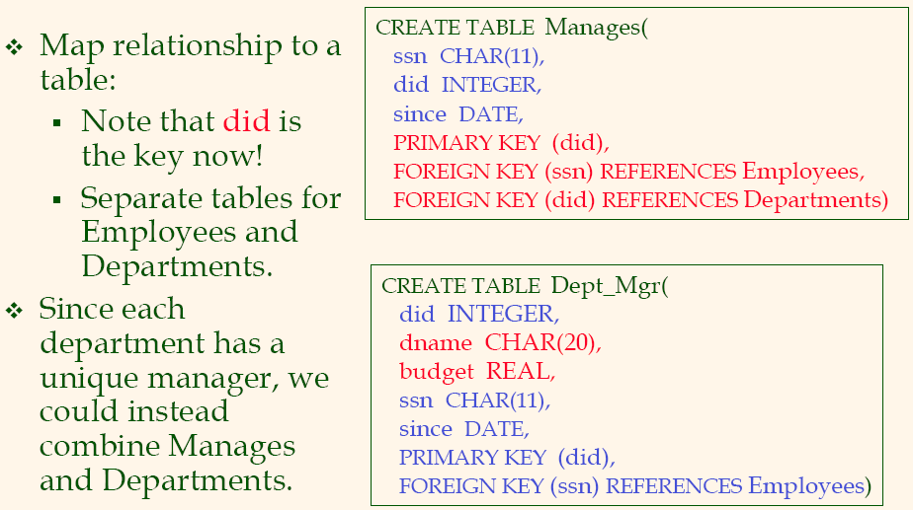
Translating ER Diagrams with Key Constraints

Slide 26
Review: Participation Constraints
Does every department have a manager?
  If so, this is a participation constraint: the participation of Departments in Manages is said to be total (vs. partial).
    Every did value in Departments table must appear in a row of the Manages table (with a non-null ssn value!)
since
since
name
name
dname
dname
ssn
did
did
budget
lot
budget
Employees
Manages
Departments
Works_In
since
Notes:
8

Slide 27
Participation Constraints in SQL
We can capture participation constraints involving one entity set in a binary relationship, but little else (without resorting to CHECK constraints).
CREATE TABLE Dept_Mgr(
did INTEGER,
dname CHAR(20),
budget REAL,
ssn CHAR(11) NOT NULL,
since DATE,
PRIMARY KEY (did),
FOREIGN KEY (ssn) REFERENCES Employees,
ON DELETE NO ACTION)
Notes:
9

Slide 28
Review: Weak Entities
A weak entity can be identified uniquely only by considering the primary key of another (owner) entity.
  Owner entity set and weak entity set must participate in a one-to-many relationship set (1 owner, many weak entities).
  Weak entity set must have total participation in this identifying relationship set.
name
ssn
lot
cost
pname
age
Employees
Policy
Dependents
Notes:
10

Slide 29
Translating Weak Entity Sets
Weak entity set and identifying relationship set are translated into a single table.
  When the owner entity is deleted, all owned weak entities must also be deleted.
CREATE TABLE Dep_Policy (
pname CHAR(20),
age INTEGER,
cost REAL,
ssn CHAR(11) NOT NULL,
PRIMARY KEY (pname, ssn),
FOREIGN KEY (ssn) REFERENCES Employees,
ON DELETE CASCADE)
Notes:
11

Slide 30
Relational Model: Summary
A tabular representation of data, simple and intuitive, currently the most widely used
  Object-relational features in most products
Integrity constraints can be specified by the DBA, based on application semantics. DBMS checks for violations.
  Two important ICs: primary and foreign keys
  In addition, we always have domain constraints.
Powerful query languages exist.
  SQL is the standard commercial one
    DDL - Data Definition Language
    DML - Data Manipulation Language

